Slide 1



Artificial Intelligence in Medicine How Can AI Help Us Understand Disease and Improve Patient Care?
Robbin Bouwmeester
https://github.com/RobbinBouwmeester/Bergen_2025_ML_ppt

Slide 2

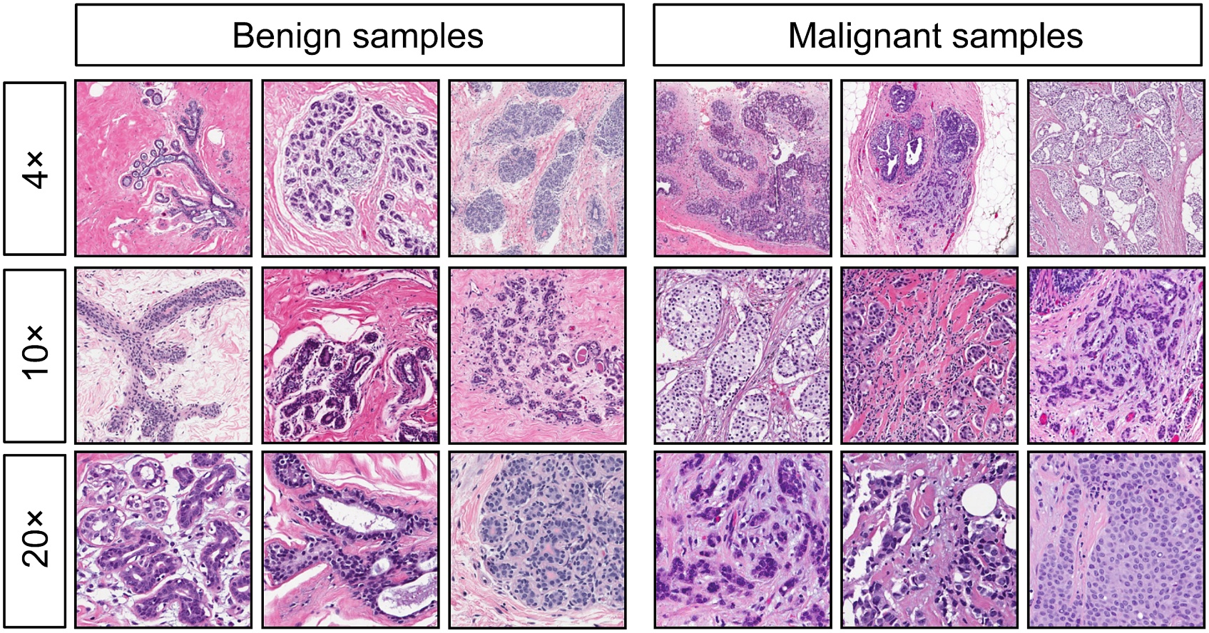
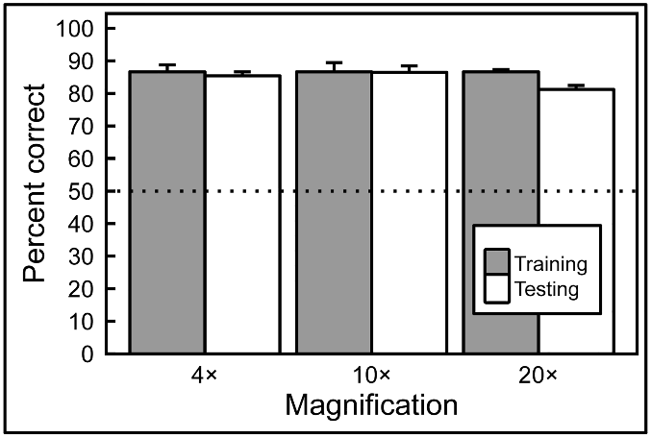
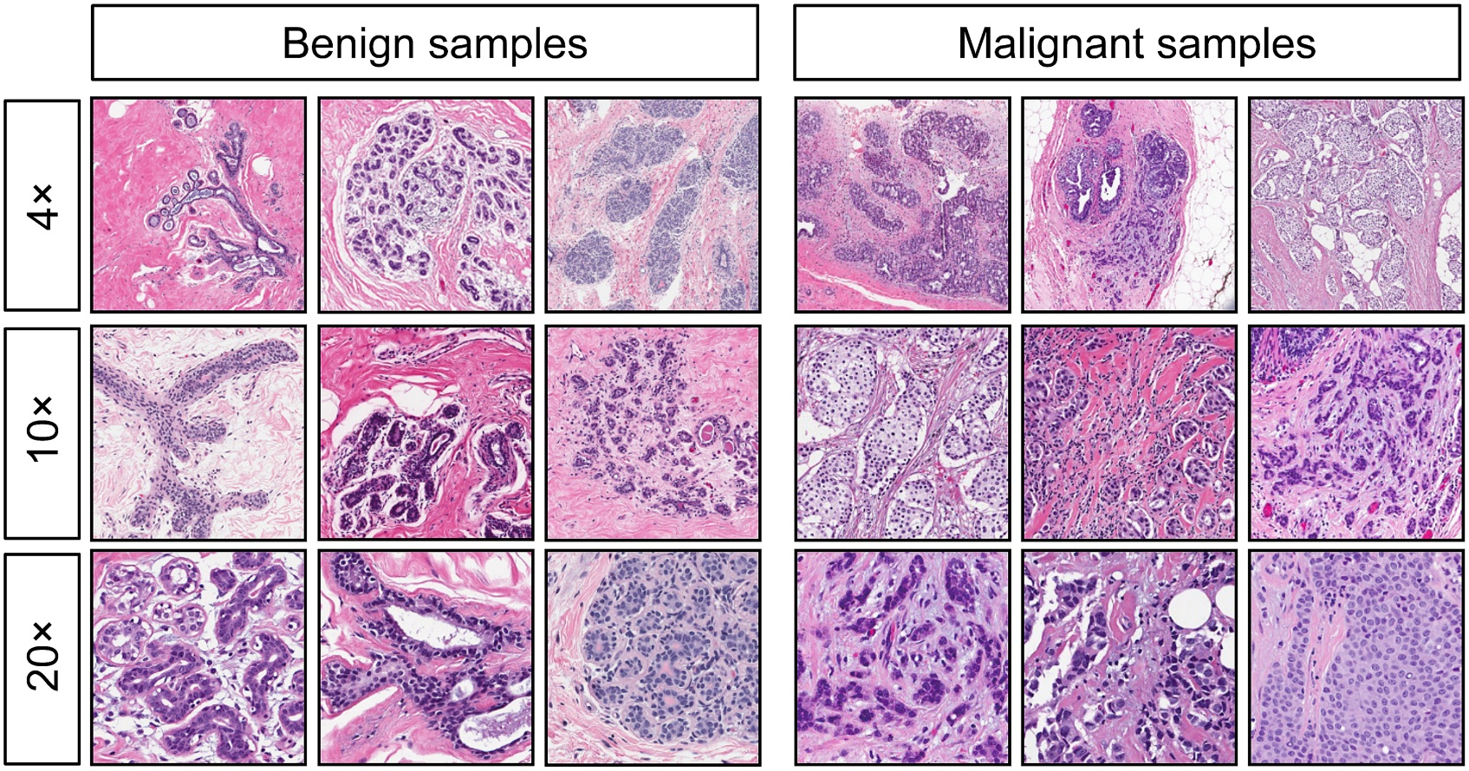
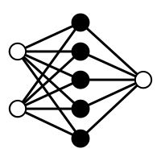
Human expert competing with Artificial Intelligence (Machine Learning model) to classify benign or malignant breast cancer slides
Human Expert
Machine Learning
Levenson et al. PLOS One (2015)
Notes:
Pigeons (Columba livia) as Trainable Observers of Pathology and Radiology Breast Cancer Images | PLOS One

Slide 3
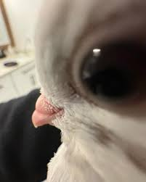
I lied; multiple pigeons learned to do this in just 14 days. However, there are similarities with Machine Learning
Human Expert
Levenson et al. PLOS One (2015)
Notes:
Pigeons (Columba livia) as Trainable Observers of Pathology and Radiology Breast Cancer Images | PLOS One

Slide 4
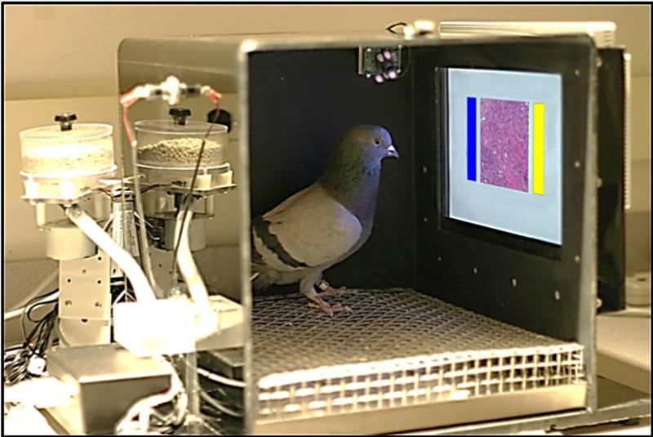
ML trains a model from experience (data) with respect to a task and performance measure that should be able to generalize
Levenson et al. PLOS One (2015)
Notes:
Pigeons (Columba livia) as Trainable Observers of Pathology and Radiology Breast Cancer Images | PLOS One

Slide 5

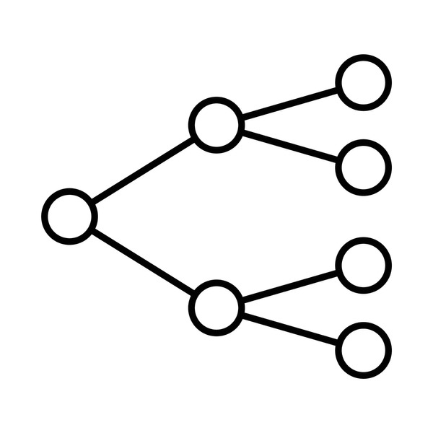
Machine learning maps between data (features) and a target value, from a trained model you can obtain predictions when providing the model with only data and an unknown target
Data (features)
Model
Target

Slide 6
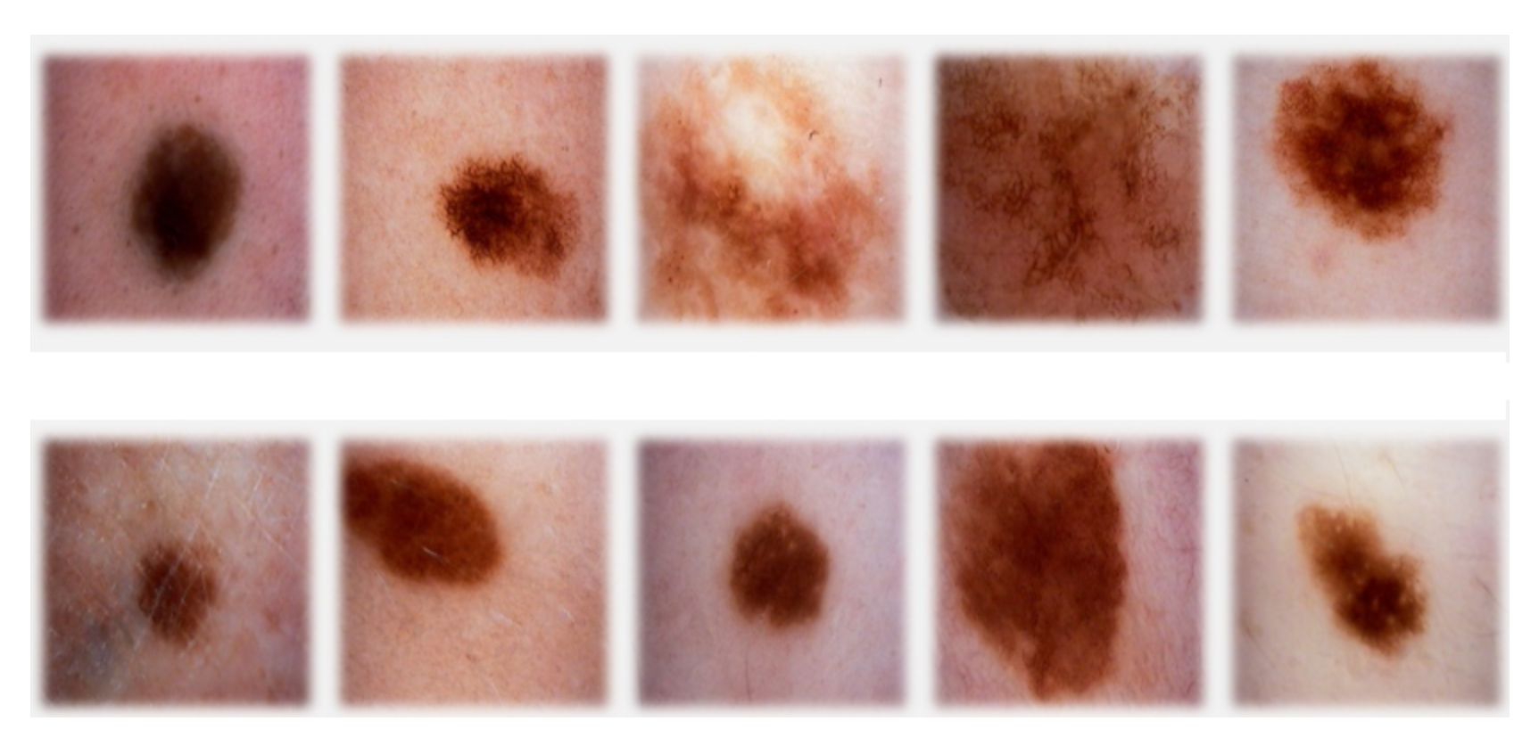
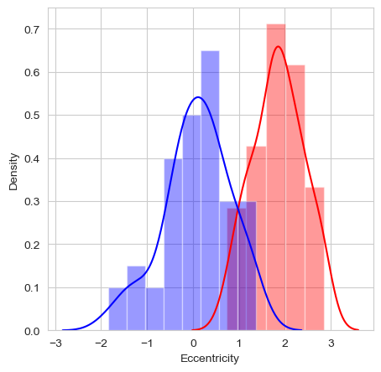
Skin melanoma as a simplified example of how a model learns;
note that a computer only works with numbers!
Data (features)
Model
Target
Eccentricity
1
<= -2.0
> -2.0
0
2
0
1
1
-0.5
1.8

Slide 7
A random decision boundary to start, the difference between predictions and target are used to move the boundary
Data (features)
Model
Predictions
Target
Eccentricity
1
1
<= -2.0
> -2.0
1
0
2
0
1
1
1
-0.5
1.8

Slide 8
A decision boundary is optimized; based on presented data for a task and performance measure that should be able to generalize
Data (features)
Model
Predictions
Target
Eccentricity
1
1
<= 1.0
> 1.0
0
0
2
0
1
1
1
-0.5
1.8

Slide 9







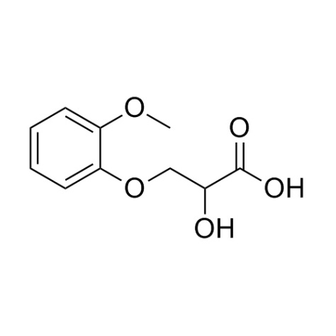
AI has an impact on many different healthcare topics; from small molecules to medical records
Biomedical analytics
Medical imaging
ECG
Drug design
Omics
Medical records

Slide 10
AI has an impact on many different healthcare topics; from small molecules to medical records
Biomedical analytics
Medical imaging
ECG
Type of data
Tabular
Type of models
Tree-based
Continuous
Neural-network
(deep learning)
Target
Disease state
Anomaly detection
Drug design
Omics
Medical records
Ning et al. Scientific Reports (2025); Lauritsen et al. Artificial Intelligence in Medicine (2020)
Notes:
https://www.nature.com/articles/s41598-025-09439-4
https://www.sciencedirect.com/science/article/pii/S0933365719303173

Slide 11
AI has an impact on many different healthcare topics; from small molecules to medical records
Biomedical analytics
Medical imaging
ECG
Type of data
Images/videos
Type of models
Tree-based
Continuous
Convolutional
Neural-network
(deep learning)
Target
Disease state
Segmentation
Anomaly detection
Drug design
Omics
Medical records
Le Dinh et al. Applied Sciences (2022)
Notes:
https://www.mdpi.com/2076-3417/12/10/4861

Slide 12
AI has an impact on many different healthcare topics; from small molecules to medical records
Biomedical analytics
Medical imaging
ECG
Type of data
Temporal ordered (sequential)
Type of models
Tree-based
Continuous
Recurrent
Neural-network
(deep learning)
Target
Disease state
Anomaly detection
Drug design
Omics
Medical records
Le Dinh et al. Applied Sciences (2022)
Notes:
https://www.nature.com/articles/s41467-020-15432-4

Slide 13
AI has an impact on many different healthcare topics; from small molecules to medical records
Biomedical analytics
Medical imaging
ECG
Type of data
Tabular
Structural (2D/3D)
Type of models
Tree-based
Continuous
Recurrent/Convolutional/Graph Neural-networks
(deep learning)
Target
Drug efficiency
IC50
Drug stability
Drug design
Omics
Medical records
Arus-Pous et al. Journal of Cheminformatics (2020)
Notes:
https://jcheminf.biomedcentral.com/articles/10.1186/s13321-020-00441-8

Slide 14
AI has an impact on many different healthcare topics; from small molecules to medical records
Biomedical analytics
Medical imaging
ECG
Type of data
Tabular
Sequential
Type of models
Tree-based
Continuous
Recurrent
Neural-networks
(deep learning)
Target
Pathogenicity
Structure
Interactions
Drug design
Omics
Medical records
Jumper et al. Nature (2021)
Notes:
https://www.nature.com/articles/s41586-021-03819-2

Slide 15
AI has an impact on many different healthcare topics; from small molecules to medical records
Biomedical analytics
Medical imaging
ECG
Type of data
Human written text
Type of models
Transformer Neural-networks (deep learning)
Recurrent
Neural-networks
(deep learning)
Target
Model the underlying textual structure
Drug design
Omics
Medical records
Yao Jiang et al. Nature (2023)
Notes:
https://www.nature.com/articles/s41586-023-06160-y

Slide 16
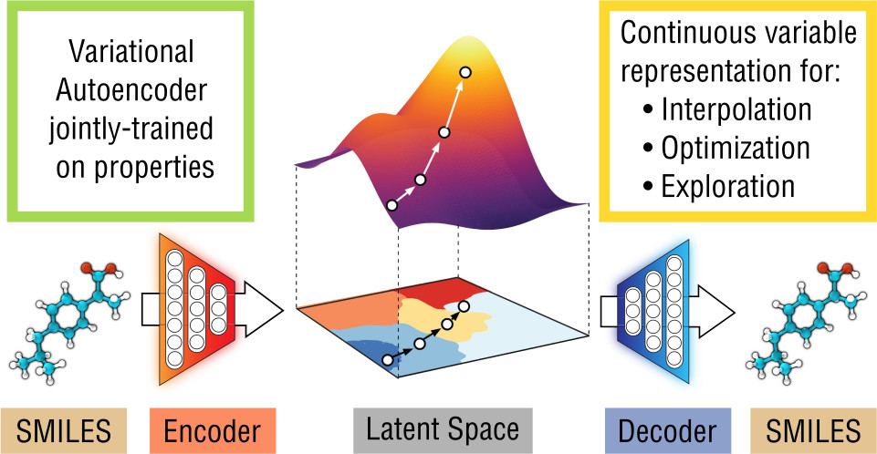
Drug design with variational auto-encoders; able to sample the latent space to find potentially interesting drugs
Gomez-Bombarelli et al. ACS Central Science (2023)
Notes:
https://pubs.acs.org/doi/10.1021/acscentsci.7b00572

Slide 17
Drug design with variational auto-encoders; able to sample the latent space to find potentially interesting drugs
Gomez-Bombarelli et al. ACS Central Science (2023)
Notes:
https://pubs.acs.org/doi/10.1021/acscentsci.7b00572

Slide 18
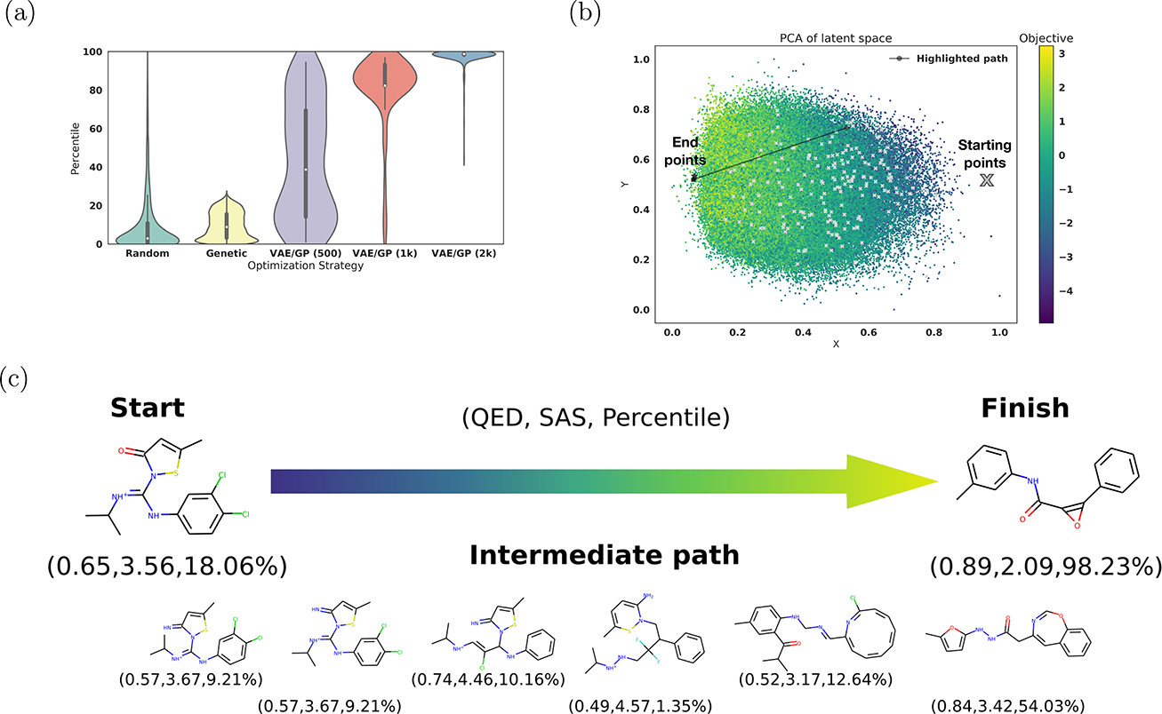
Reconstructing ibuprofen-like molecules yields much higher percentile (likeness) scores for the variational autoencoder
Gomez-Bombarelli et al. ACS Central Science (2023)
Notes:
https://pubs.acs.org/doi/10.1021/acscentsci.7b00572

Slide 19

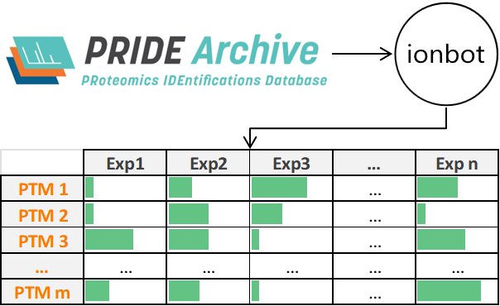
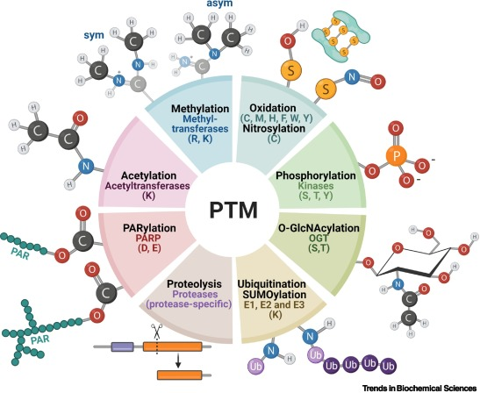
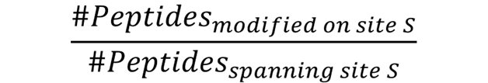
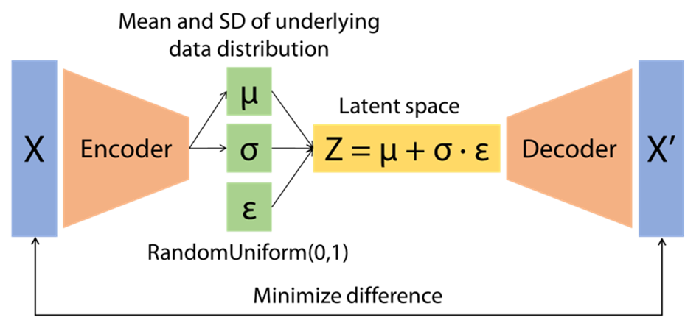
A VAE map of proteome-wide phosphosite co-occurrence reveals some interesting patterns, including kinase clusters
Enrico Massignani
Koutrouli et al. Bioinformatics (2024)
Notes:
FAVA: high-quality functional association networks inferred from scRNA-seq and proteomics data | Bioinformatics | Oxford Academic

Slide 20
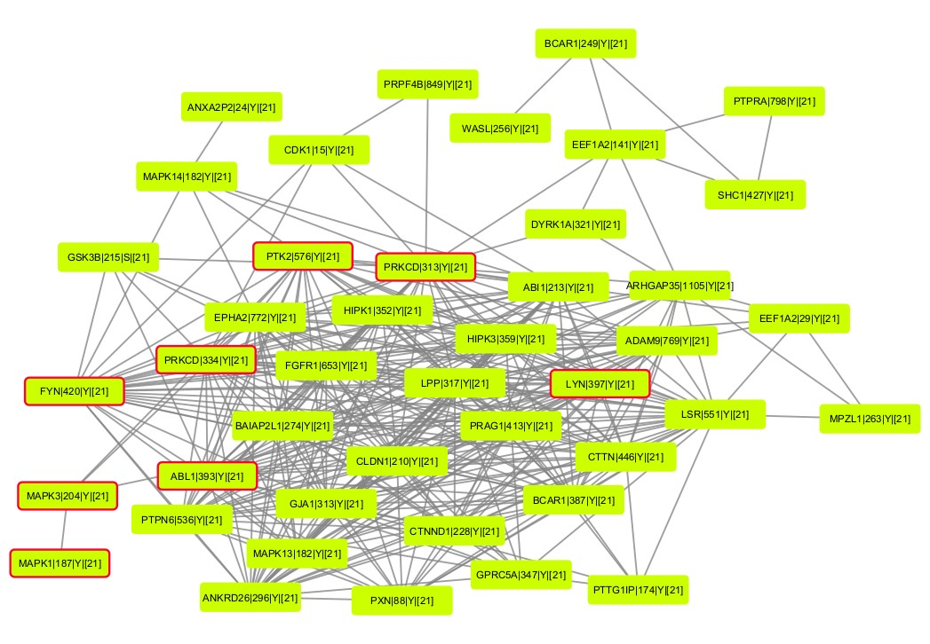
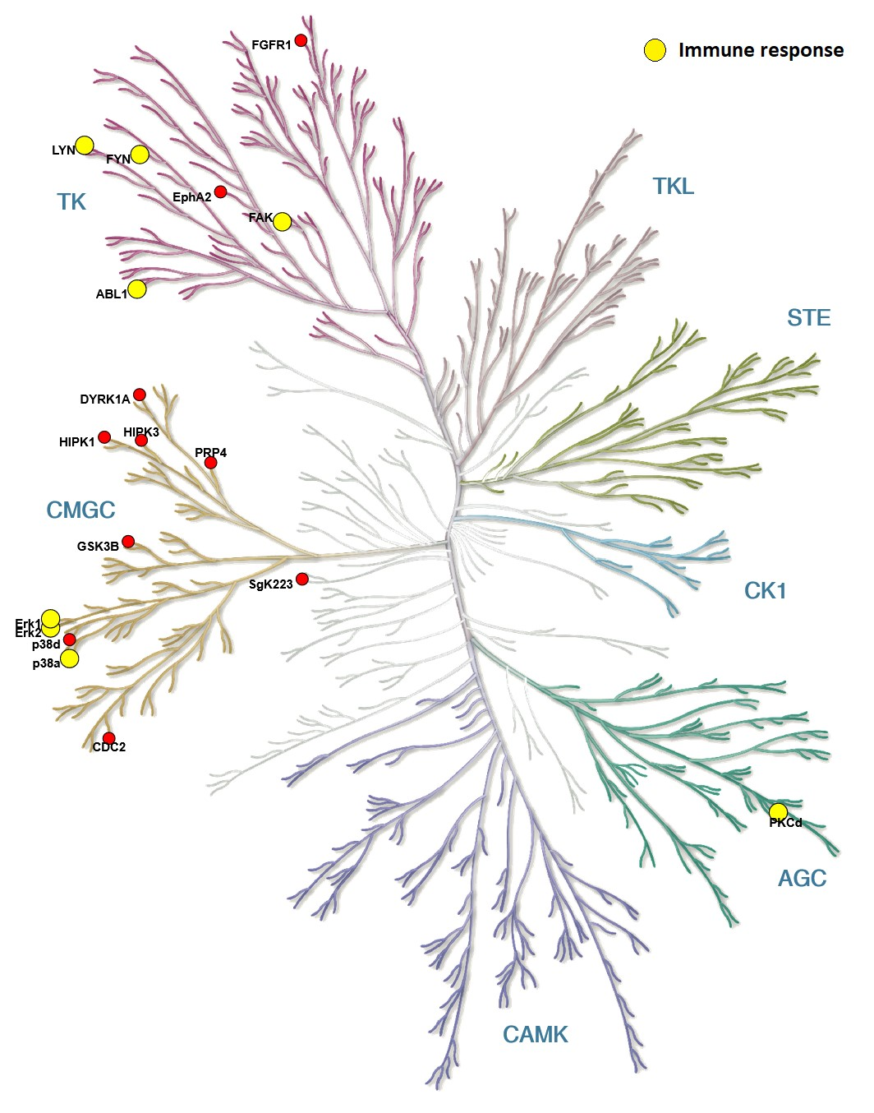
These phospho clusters contain connected components, here shown for tyrosine kinases and their key targets
Enrico Massignani
Koutrouli et al. Bioinformatics (2024)
Notes:
FAVA: high-quality functional association networks inferred from scRNA-seq and proteomics data | Bioinformatics | Oxford Academic

Slide 21
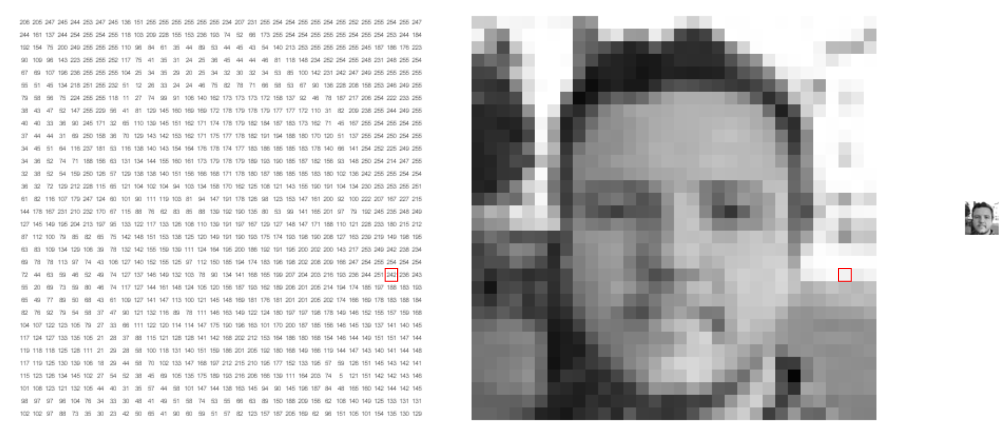
Computer vision is a large subfield in AI that deals with 2D and 3D images and videos
https://setosa.io/ev/image-kernels/

Slide 22
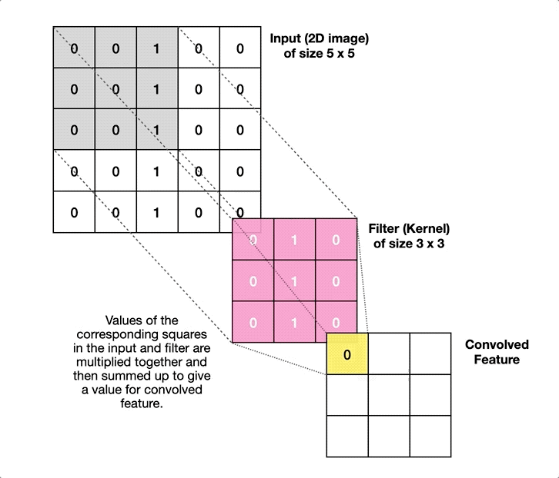
Filters are used to obtain small and unlocalized features of images that can be combined in subsequent convolutional layers

Slide 23
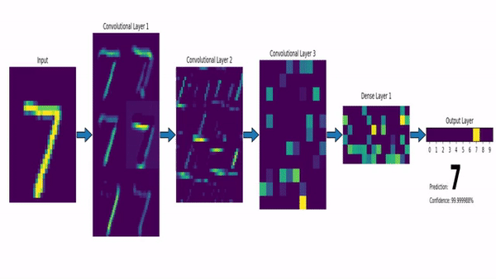
Filters are used to obtain small and unlocalized features of images that can be combined in subsequent convolutional layers

Slide 24
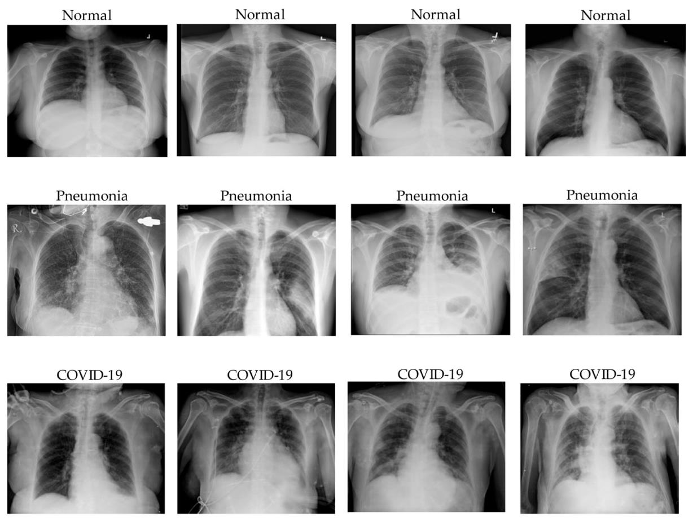
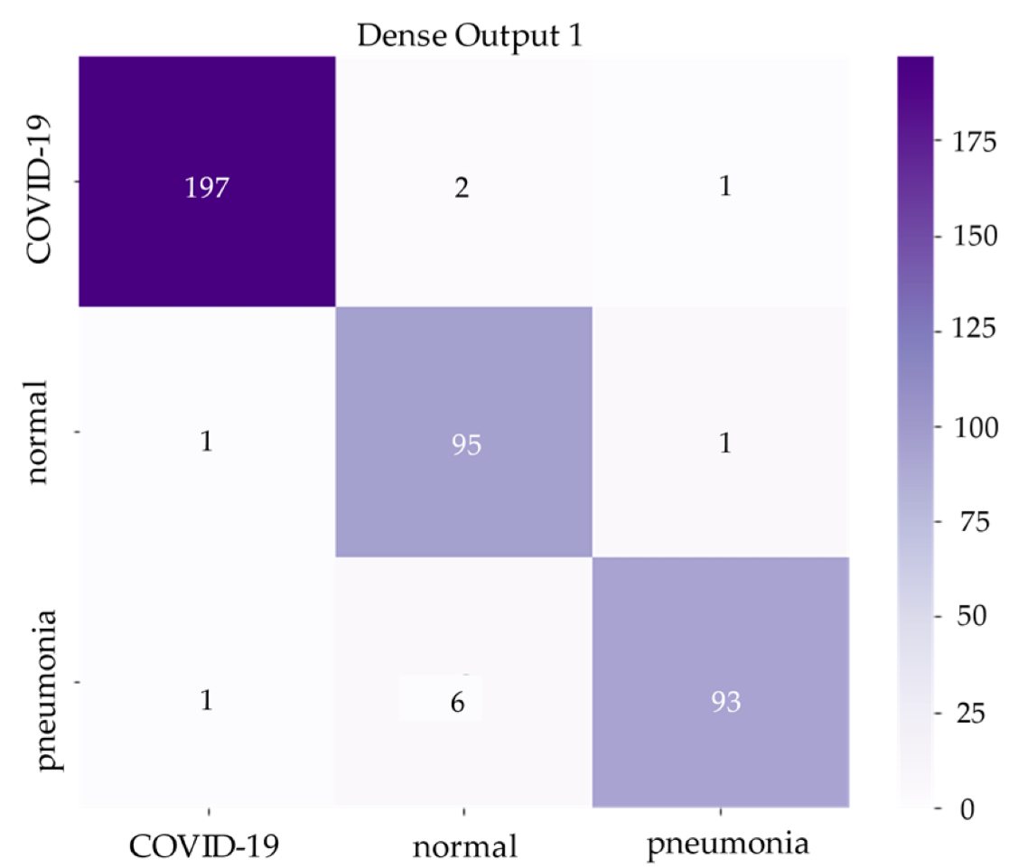
COVID can be detected with high sensitivity and specificity, and also be distinguished from pneumonia
Predictions
True labels
Dinh et al. Appl. Sci. (2022)
Notes:
COVID-19 Chest X-ray Classification and Severity Assessment Using Convolutional and Transformer Neural Networks

Slide 25
Artificial Intelligence in Medicine How Can AI Help Us Understand Disease and Improve Patient Care?
Robbin Bouwmeester

Slide 26
ML trains a model from experience (data) with respect to a task and performance measure that should be able to generalize
Levenson et al. PLOS One (2015)
Notes:
Pigeons (Columba livia) as Trainable Observers of Pathology and Radiology Breast Cancer Images | PLOS One

Slide 27
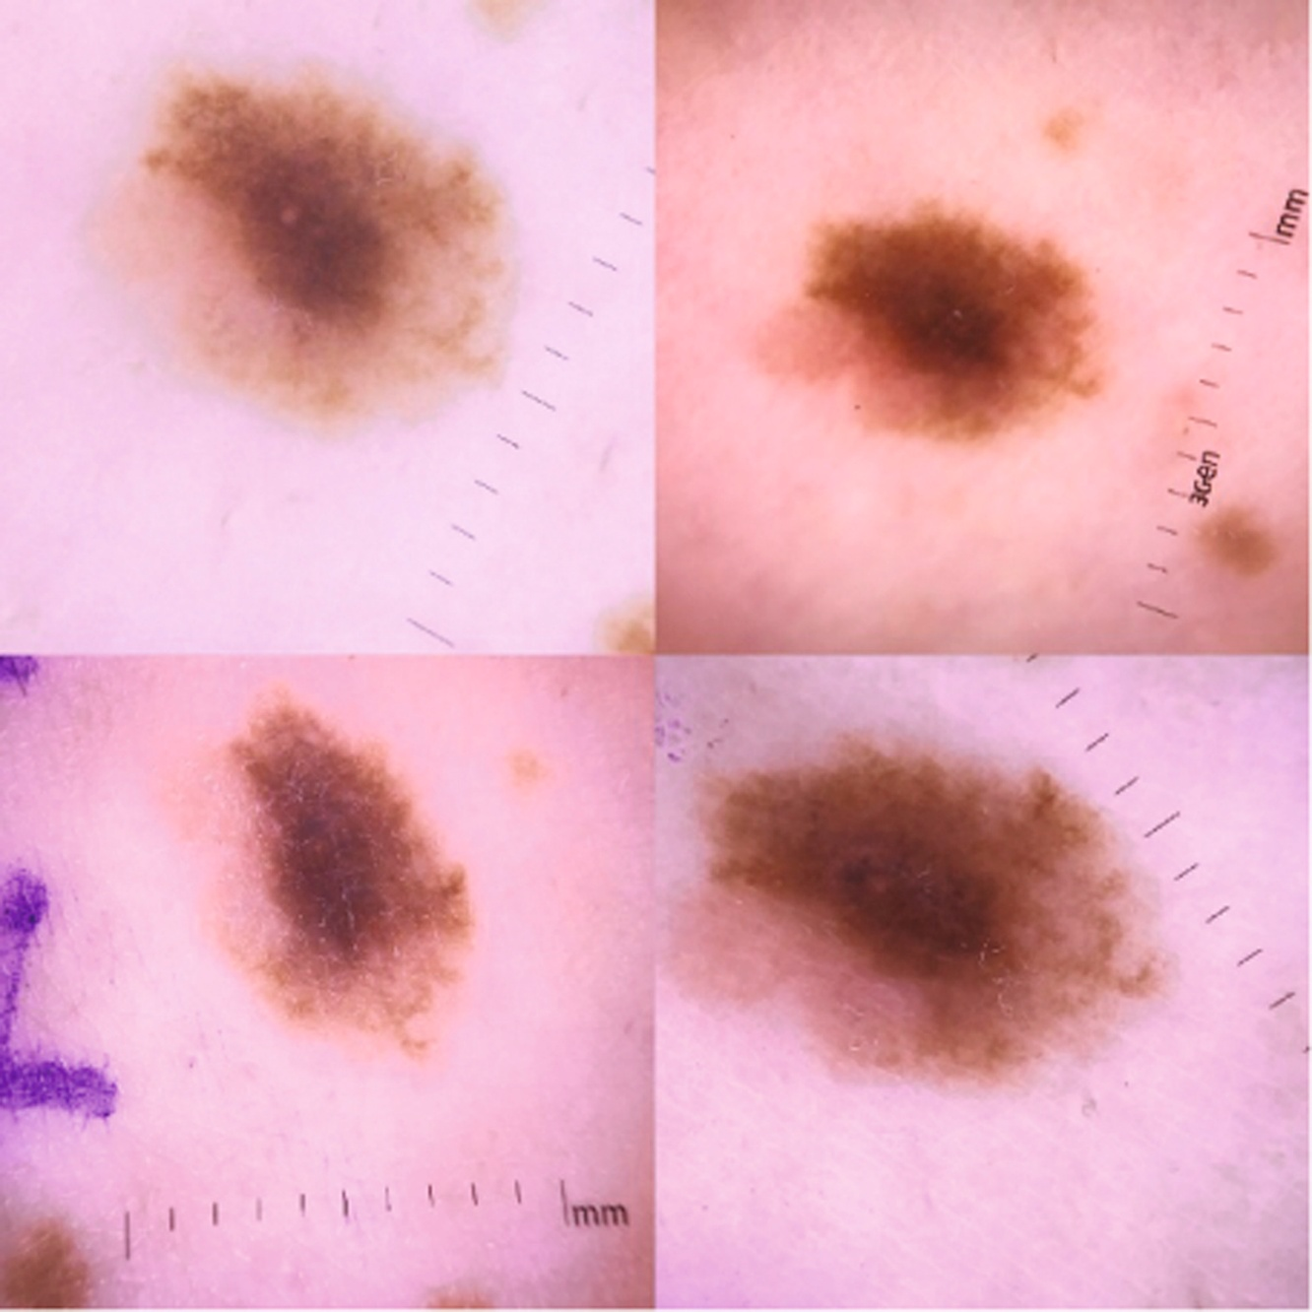
AI cares about optimizing the objective function; AI can cheat
Narla et al. J Invest Dermatol (2018)
Notes:
Automated Classification of Skin Lesions: From Pixels to Practice - PubMed

Slide 28
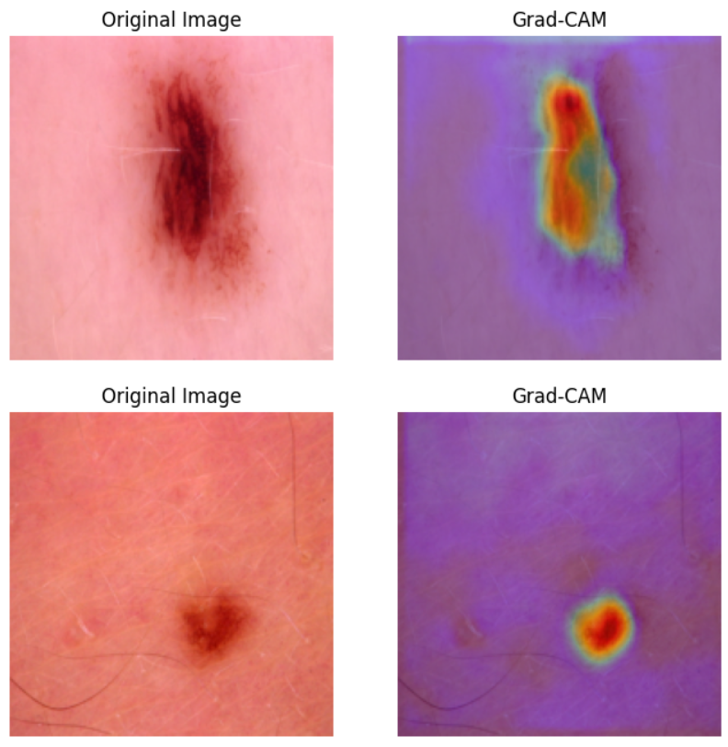
AI cares about optimizing the objective function; AI can cheat
Narla et al. J Invest Dermatol (2018)
Automated Classification of Skin Lesions: From Pixels to Practice - Akhila Narla ∙ Brett Kuprel ∙ Kavita Sarin ∙ Roberto Novoa ∙ Justin Ko
Notes:
Automated Classification of Skin Lesions: From Pixels to Practice - PubMed

Slide 29

AI cares about optimizing the objective function; AI can cheat
github.com/CompOmics/ML-course-VIB-2024
Narla et al. J Invest Dermatol (2018)
Automated Classification of Skin Lesions: From Pixels to Practice - Akhila Narla ∙ Brett Kuprel ∙ Kavita Sarin ∙ Roberto Novoa ∙ Justin Ko
Notes:
Automated Classification of Skin Lesions: From Pixels to Practice - PubMed

Slide 30

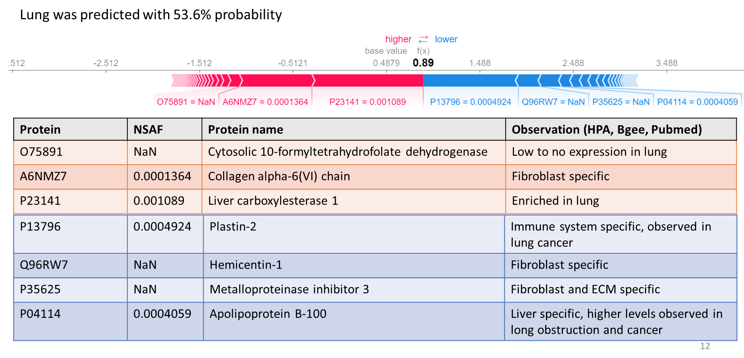
Although the model is only trained on healthy tissue data, it can provide insight into changes in cancerous samples

Slide 31



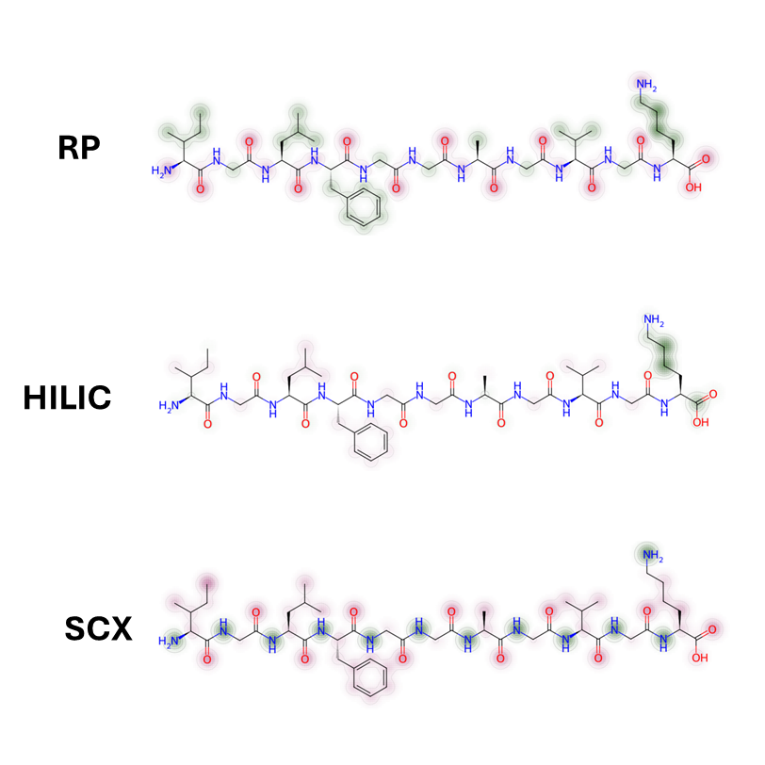
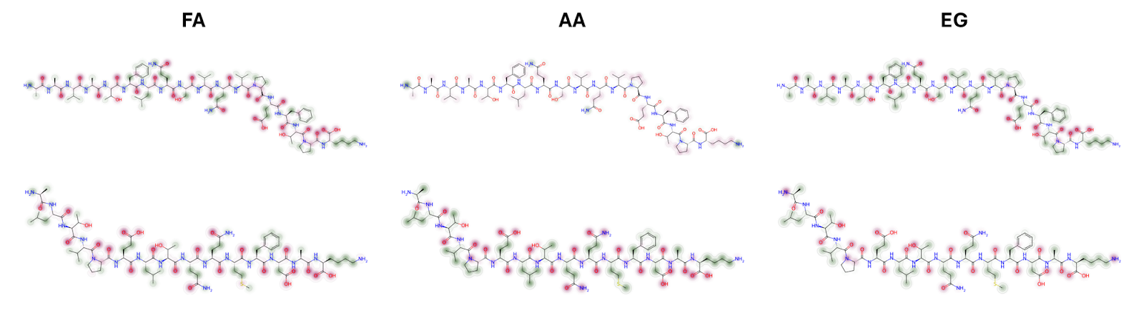
Saliency maps to gain fundamental knowledge on the retention mechanism
Jiří Urban
Katerina Hruzova
RP
(Hydrophobicity)
FA
(Formic Acid)
Positive retention time contribution
Negative retention time contribution
AA
(Acetic Acid)
HILIC
(Hydrophilicity)
EG
(Ethylene Glycol)
SCX
(cation interactions)
Notes:
Pep1: ILFGGAGVK
Pep2: AAVATFLQSVQVPEFTPK

Slide 32
Conclusion and outlook
ML trains a model from experience (data) with respect to a task and performance measure that should be able to generalize
Different objectives, ML algorithms, and input data:
disease state, anomaly detection, segmentation, drug efficiency, IC50, drug stability, pathogenicity, structure, interactions, textual structure
tree-based, continuous, neural-network, recurrent NN, convolutional NN, transformer (LLM)
tabular, image, video, temporal ordered, sequence, structural, textual
Enormous amount of potential on a wide variety of problems
Future lies in a hybrid of humans working with AI, this also partly circumvents ethical and legal issues (there are still many ethical and legal issues though!)
https://github.com/RobbinBouwmeester/Bergen_2025_ML_ppt

Slide 33
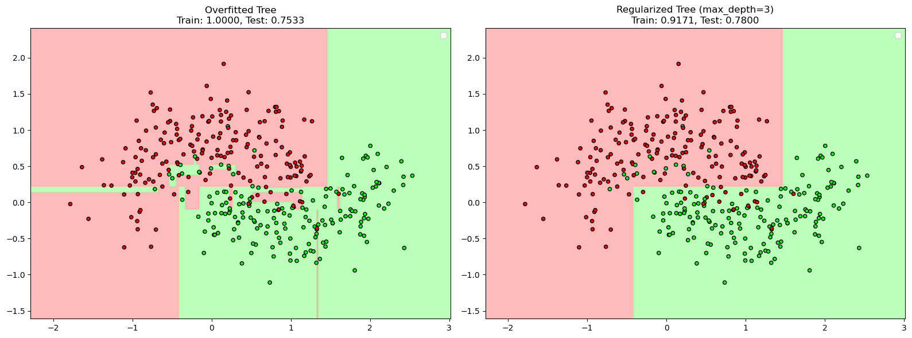
AI cheating

